Slide 1
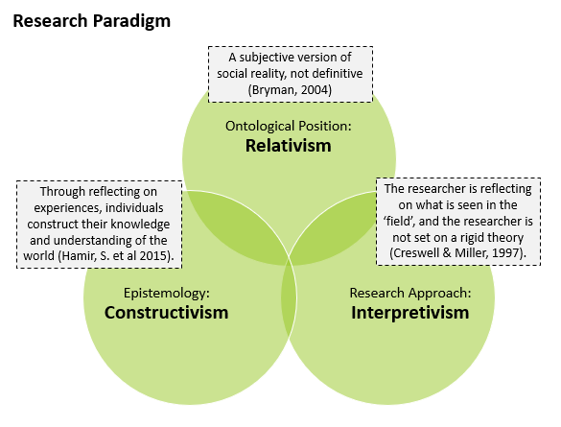
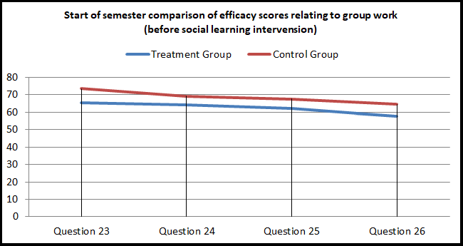
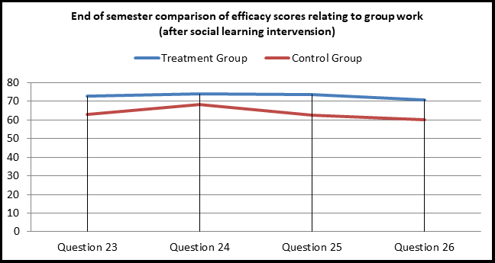
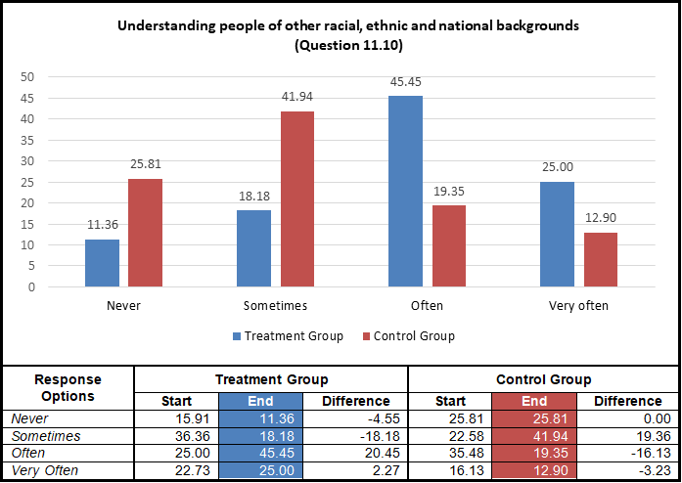
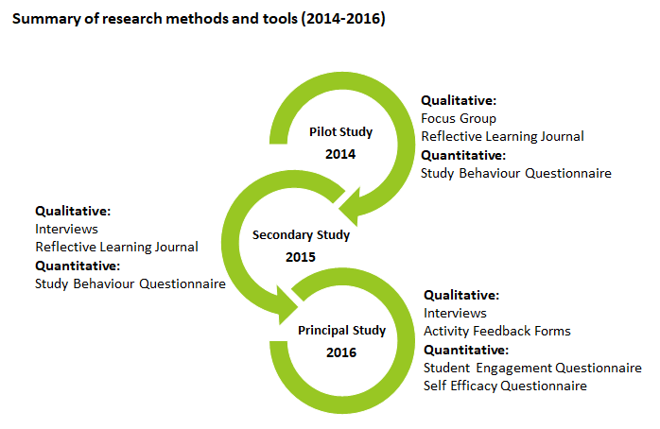
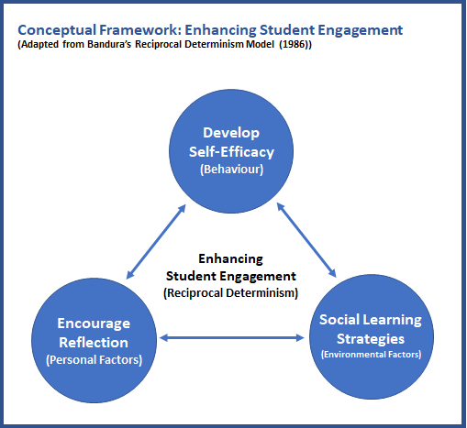
Predicting the European Wage Gap Using KNN, CART and SVC Models
Yumiko Bejarano, CCT College Dublin / University of Hertfordshire, May 2019
ABSTRACT
RESEARCH PARADIGM
FINDINGS
Self Efficacy
This research set out to enhance engagement in computer programming, a known difficult subject area for 1st year BSc in IT students. Programming lecturing staff had strong reservations about introducing group work in their classes, claiming group work was a counter-productive learning approach. The study was framed on a mixed methods action research approach, and a number of interventions, centred on reflective learning and social learning, were introduced. The findings indicate a strong preference by students to work in groups when tackling computer programming problems, but no strong evidence was found that reflective or social learning activities enhance programming skill level. A key contribution to practice was the introduction of a student mentoring academy within the institution, with programming as a central theme.
The empirical research studies were based on an interpretative approach, which allowed for greater freedom to include personal views and interpretations, and to form knowledge inductively from views and experiences of participants. The diagram below characterises the research paradigm for this study, which can be described as a loose collection of logically related assumptions, concepts, or propositions that orient thinking and research (Bogdan and Biklen, 1998).
Reflective Learning
Participants were provided a self-efficacy questionnaire, based on a approach suggested by Bandura (2006), to complete at the start and end of a semester. A social learning intervention was introduced to a treatment group, and the overall self-efficacy group score comparison revealed very little, other than a slight increase in the treatment group score. However, a significant finding was found when comparing the final four questions measuring the perceived ability to work within a group. To illustrate this, the first figure below represents the start of semester self-efficacy group score for both groups, followed by the second figure representing the end of semester self-efficacy score reversal.
A reflective learning journal was provided to student participants in two of the action research studies, participants were asked to complete this journal on a weekly basis over the course of a semester. There was mixed opinions on the use of the journal, with the majority questioning its usefulness. Students were not convinced of the benefits of using the journal over a long period of time, and found the activity a burden in some cases. Some viewed it as a piece of additional assessment that had no grade, furthering most to question the benefits. While some positive benefits were noticed, careful consideration is required if using such a tool for a class cohort, some individuals seemed to adapt better to this type of journaling activity than others.
Student Engagement
RESEARCH QUESTIONS
A student engagement measurement tool was provided to student participants at the start and end of a semester. A social learning intervention was applied to a treatment group, and the engagement scores across both the control and treatment groups were measured. The results revealed a small increase in total student engagement group score for the treatment group, but nothing significant. However, interesting findings were found in some of the individual questions, the figure below represents one an example of this, in which the treatment group had scored considerably higher than the control group in a question relating to understanding people dissimilar to themselves, which would have been influenced through the social learning activities that the treatment group participated in. This, in itself, was an encouraging finding.
The four questions below represent the core focus of the entire study:
Q.1. Is a Reflective Learning Journal a useful and effective tool for engaging students in computer programming?
Q.2. Can the use of social learning strategies enhance student engagement?
Q.3 Are social learning strategies, such as Problem Based Learning and Peer Assisted Learning, effective tools in engaging students in computer programming?
Q.4 Can the use of social learning strategies enhance self- efficacy in computer programming?
Research Methods
The diagram below highlights the methods and tools used over the course of the action research study.
CONCEPTUAL FRAMEWORK
The conceptual framework below, was developed from Bandura’s (1986) Reciprocal Determinism model, in which Behaviour, Environmental Factors and Personal Factors were replaced with Self-Efficacy, Social Learning and Reflection, which became the basis for developing implementation strategies to enhance student engagement.
CONCLUSIONS
A summarised answer to the research questions are presented below:
Q.1. Both of the studies on the use of a reflective learning journal were mostly negative, in that students did not find it beneficial, and in some cases, saw it as an additional ungraded piece of assessment .
Q.2. There was evidence to suggest it does, specifically relating to group based activities, and communicating with peers. However, it is difficult to say positive findings were directly linked to the social learning activities introduced over the semester.
Q.3 The use of PBL and PAL was very successful in engaging students in computer programming, the students engaged in the activities and requested more of these activities in the future.
Q.4 There was no strong evidence to suggest social learning improved self-efficacy in computer programming, however, there was strong evidence found that participating in group work enhances self-efficacy in working with others in group activities.
Data Collection
Social Learning (PBL and PAL activities)
The table below is a summary of the data collected for the study.
Problem Based Learning (PBL) and Peer Assisted Learning (PAL) were introduced to a treatment group over the course of a semester. The quotes below represent a small sample of the overall positive feedback the participants expressed in terms of their enjoyment in participating in groups when solving programming problems:
“I learned I can work in a group. Although I most of the times would rather work alone, working in a group does make problem solving a lot easier”.
“I enjoy programming but I’m 100% aware that my planning skills are way better than my programming skills. I wish we had more opportunities like this one to practice”.
“Really enjoyable as I am better working with people. (I’m a really nervous person and individual evaluations makes me so nervous that I cannot concentrate)”.
“These activities really makes more interaction among friends and for a given problem, we can solve it with many the best ways. And need to be continued in the coming weeks”.
Pilot Study - 2014 | Analysis | Sample
Student study habits questionnaire | Quantitative | 31
Reflective Learning Journal | Qualitative | 77
Focus group (reflective journal evaluation) | Qualitative | 7
Secondary Study - 2015 | Analysis | Sample
Student study habits questionnaire | Quantitative | 53
Reflective Learning Journal | Qualitative | 18
Interview (Journal evaluation and Study habits) | Qualitative | 4
Principal Study - 2016 | Analysis | Sample
Student Engagement & Self-Efficacy Questionnaire – (Treatment Group) | Quantitative | 44
Student Engagement & Self-Efficacy Questionnaire –(Control) | Quantitative | 31
Interview (start and end of semester with principal programming lecturer ) | Qualitative | 1
Interview (end of semester with treatment group participants) | Qualitative | 4
PBL/PAL activity feedback forms (5x sessions) | Qualitative | 46
REFERENCES
Bandura, A. (1986). Social Foundations of Thought and Action: Social Cognitive Theory. U.S.A: Pearson Education.
Bandura, A. (2006). Guide for constructing self-efficacy scales. In F. Pajares, & T. Urdan (Eds.), Adolescence and education: Vol. 5. Self efficacy and adolescence (pp. 307-337). Greenwich, CT: Information Age.
Bogdan, R.C., Biklin, S.K. (1998). Qualitative research for education: An introduction to theory and methods. (3rd edition). Boston: Allyn and Bacon.
Bryman, A. (2004). Social Research Methods. U.K.: Oxford University Press.
Creswell, J.W., Miller, G.A. (1997). Research Methodologies and Doctoral Process. New Directions for Higher Education, no.99. U.S.A.: Wiley.
Hamir, S., Maion, S., Tice, S., & Wideman, A. (2015) Constructivism in
Education. Available at: http://constructivism512.weebly.com . Accessed 27th February 2018.
Miles, M.B., & Huberman, A.M. (1994). Qualitative data analysis: A sourcebook of new methods. Thousand Oaks, CA: Sage.

Slide 2
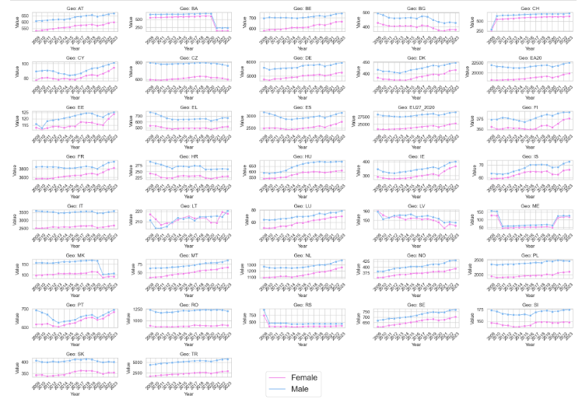
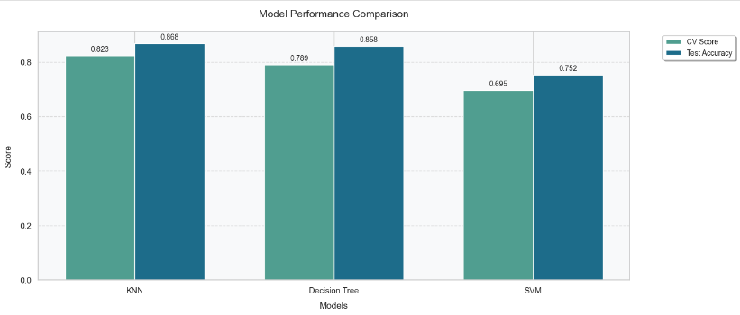
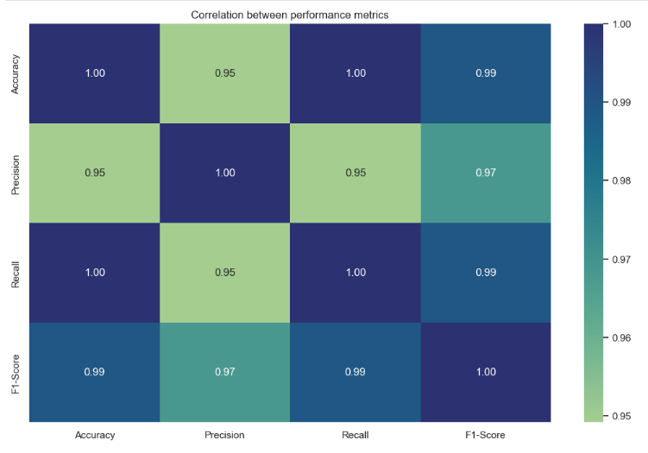
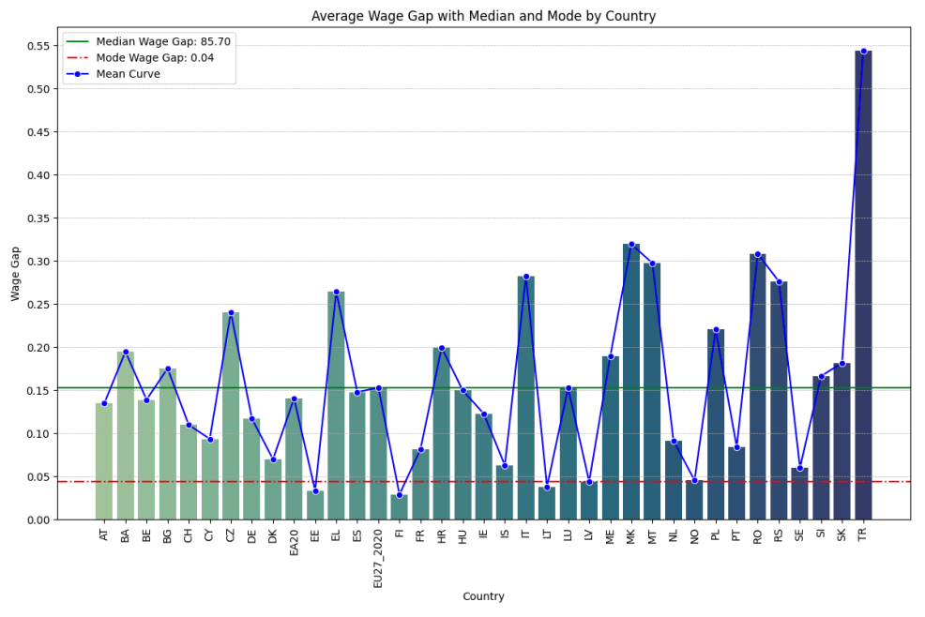
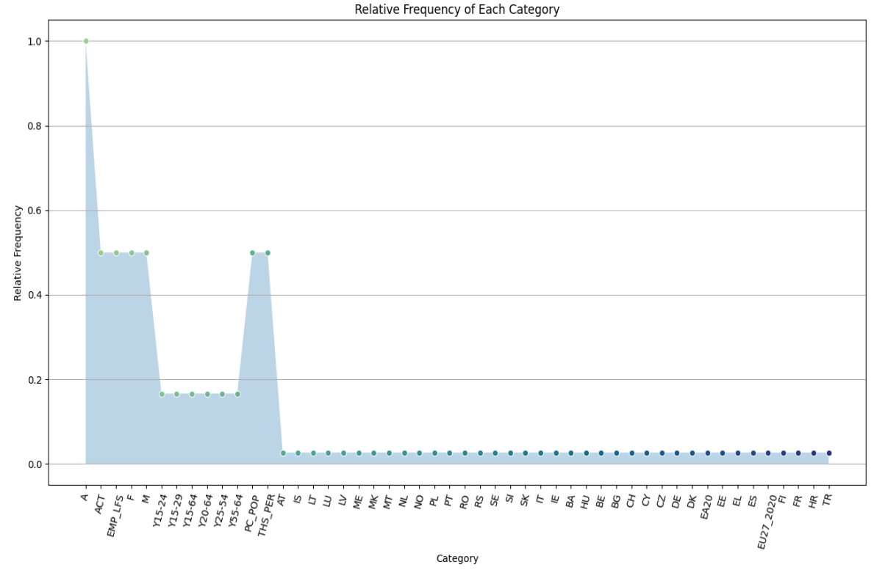

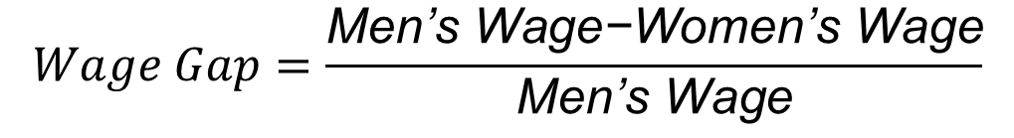
EXPLORING THE GENDER WAGE GAP IN EUROPE: PREDICTIVE MODELING USING KNN, CART, AND SVC
University, Nov 2024
INTRODUCTION
CHALLENGES ENCOUNTERED
Key Formula:
Additional Cross-Validation
The gender wage gap remains a persistent issue across Europe, where disparities in income between men and women are evident. This project uses a machine learning approach to examine wage differences across various demographics using Eurostat data. The goal is to identify and analyze the factors contributing to these to promote gender equity in the workforce.
Data Quality: Missing values and outliers handled with imputation and filtering; rows with less than 85% completeness removed.
Class Imbalance: Techniques like SMOTE were used to balance wage categories, improving model performance on minority classes.
High Dimensionality: Feature selection using correlation, SelectKBest, and Lasso regularization to improve model efficiency.
Overfitting: Cross-validation and hyperparameter tuning, along with Decision Tree pruning, helped maintain model generalizability.
$$Wage Gap=\frac{\text{Men}\text{’}\text{s} \text{Wage}\text{−}\text{Women}\text{’}\text{s} \text{Wage}}{\text{Men}\text{’}\text{s} \text{Wage}}$$
An additional cross-validation confirmed KNN’s high consistency and stability across folds, reinforcing its reliability in wage gap prediction. The Decision Tree showed variability, highlighting some overfitting, while SVM remained moderately consistent but generally underperformed. This validation underscores KNN’s robustness for accurate wage gap analysis.
Model Performance Comparison
RESULTS AND ANALYSIS
In comparing model performance, the K-Nearest Neighbors (KNN) model proved the most effective for predicting wage gaps, achieving an accuracy of 86.76% with balanced precision and recall, indicating strong generalizability and minimal overfitting. The Decision Tree model stability and struggled particularly in handling complex patterns in wage data. Overall, KNN demonstrated the best balance between accuracy and consistency across wage gap categories, making it the most suitable model for addressing the complexities of wage disparity analysis.
Exploratory Data Analysis (EDA)
The dataset comprises a balanced distribution of categorical variables like gender (50% male, 50% female) and employment indicators. Numerical data reveals a in recent years. This stability in mean and median salaries supports more relable comparisons post-2009. Charts displaying categorical distributions and mean salary trends over time highlight these insights.
BUSINESS DESCRIPTION
This study explores wage disparities between men and women in Europe through data analysis, using the Eurostat dataset to uncover factors driving income inequality and suggesting strategies % accuracy in predicting wage disparities.
Data Completeness: Ensuring data gaps are below 15% after cleaning and imputation.
Bias Reduction: Achieving balanced representation across wage categories through class balancing techniques.
EDA Component | Description | Key Insights | Suggested Visualization
Categorical Variables | Gender, Age, Employment Indicator, Geographic Areas | Balanced distribution (e.g., gender 50/50) | Bar Chart for each categorical variable
Numerical Variables | Wage values (Min, Max, Mean, Median, Mode) | Increase in records and variability post-2009 | Line Chart for mean wage over years
Missing Data | Significant missing values in certain years, especially pre-2009 | Affects trend analysis and accuracy | Heatmap of missing data across years
Outliers | Data spread with outliers from 2003-2004, concentration improves post-2005 | Indicates increased data consistency over time | Boxplots by year for outliers
Feature Selection
Feature selection involved techniques like Correlation, Univariate Selection, Lasso Regularization, and Recursive Feature Elimination (RFE). Lasso and RFE effectively identified the most predictive features, improving model training efficiency. A bar chart visualized the selected features, displaying their importance scores and relevance across the different methods for easy interpretation.
CONCLUSIONS
Superior Performance of KNN Model
The KNN model proved to be the most effective and reliable for predicting wage disparities, showing high accuracy (86.76%), balanced precision, and robust generalizability across low, medium, and high wage gap categories.
Model Comparison Highlig\hts
Decision Tree: Achieved competitive accuracy but exhibited overfitting, especially in the medium wage gap category, leading to increased variance in predictions.
SVM: Displayed moderate consistency but struggled with complex data patterns, disparities that need to be addressed.
Policy Implications and Recommendations
Data-Driven Strategies: Insights from machine learning models like KNN can help organizations and policymakers understand the factors driving wage inequality and develop effective, data-driven policies.
Targeted Measures: The consistent patterns of wage disparities point to the need for specific interventions in regions and sectors with the largest gaps.
Promoting Pay Equity: By focusing on fair compensation structures, transparent promotion processes, and gender-inclusive workplace practices, organizations can take actionable steps to close the gender wage gap.
Broader Impact
Implementing these recommendations can foster a more inclusive and equitable workforce, ultimately contributing to a fairer society where all individuals have equal opportunities to succeed and advance, regardless of gender.
TECHNOLOGIES USED
Boxplots for Outliers
Models
K-Nearest Neighbors (KNN): Classifies and predicts wage disparities based on similarity.
Machine Learning Algorithms
Three models (KNN, CART, SVC) provide comparative insights on wage disparity predictions.
Optimization
Cross-Validation: 5-fold to ensure robust model performance.
Hyperparameter Tuning: Adjusted key parameters in each model for improved accuracy.
Outlier analysis shows substantial data variability from 2003 to 2004, but as data concentration improves from 2005, the number of outliers reduces. This trend indicates increased consistency in recent years. Boxplots of wage distributions over time reveal how variability has evolved, supporting more accurate wage comparisons in later periods.
Modeling and Evaluation
In predictive modeling, K-Nearest Neighbors (KNN) with k=5k = 5k=5 was the most successful, reaching an accuracy of 86.76% with well-balanced precision and recall. The Decision Tree model achieved an accuracy of 85.82% at a depth of 7 but showed some overfitting. These findings suggest KNN as a robust model for predicting wage gaps, with radar charts highlighting the comparative performance of each model.
WHAT HAS BEEN ACCOMPLISHED SO FAR
Data
Dataset: 1776 samples with 27 variables from Eurostat, covering demographics, employment, and wages.
Attributes: Gender, age, employment status, region, wage info, and frequency.
Descriptive Stats: Average salaries show a wage gap; gender distribution is balanced.
Visualization: Charts and heatmaps reveal trends and outliers.
Preparation: Imputed missing values, encoded categories, and scaled features.
Models
Trained and evaluated KNN, CART, and SVC to identify top performers for wage gap predictions.
Wage Gap Analysis
REFERENCES
The wage gap analysis demonstrates a persistent trend where women generally earn less than men across countries and years. This disparity is captured in an average wage gap of 15.9% between genders, calculated as the difference between men’s and women’s wages divided by men’s wages. Line charts illustrating wage trends for both genders underscore the need for addressing systemic gender wage disparities across regions.
Chapman, P., Clinton, J., Kerber, R., Khabaza, T., Reinartz, T., Shearer, C. and Wirth, R. (2000). Step-by-step data mining guide. [online] Available at: https://www.the-modeling-agency.com/crisp-dm.pdf.
Chatgpt.com. (2024). Available at: https://chatgpt.com/share/681cfb33-4726-43ca-8d24-3a2431901e84 Get instant answers, find inspiration, learn something new.
Kazil, J. and Jarmul, K. (2016). Data Wrangling with Python: Tips and Tools to Make Your Life Easier. [online] Google Books. ‘O’Reilly Media, Inc.’ Available at: https://books.google.ie/books?id=XmeDCwAAQBAJ&printsec=copyright&redir_esc=y#v=onepage&q&f=false [Accessed 22 May 2024].
Müller, A.C. and Guido, S. (2017). Introduction to machine learning with Python : a guide for data scientists. Beijing: O’reilly.
Peng, R.D. and Matsui, E. (2015). The art of data science : a guide for anyone who works with data. Victoria, British Columbia: Lulu.com.
Python, R. (n.d.). Using k-Nearest Neighbors (kNN) in Python – Real Python. [online] realpython.com. Available at: https://realpython.com/courses/knn-python/ [Accessed 22 May 2024].
VanderPlas, J. (n.d.). Handling Missing Data | Python Data Science Handbook. [online] jakevdp.github.io. Available at: https://jakevdp.github.io/PythonDataScienceHandbook/03.04-missing-values.html.

